Slide 1

G R O U P 17
Daniel, Andrei, Luke, Yurii

Slide 2
Sumo Digital Brief
Single Player
Identify integral mechanics of a genre or game type
Develop game without specific mechanic
Substitute mechanic with refined solution
Emphasis on a single mechanic

Slide 3
Our Response
Substitute refined controlled movement for launch mechanic
Simple Input – Emphasis on mechanic
Non-twitch/ Puzzler gameplay
We want our players to experience fiero and joy
Hard fun (challenge)
Learn – Practice – Master game loop

Slide 4
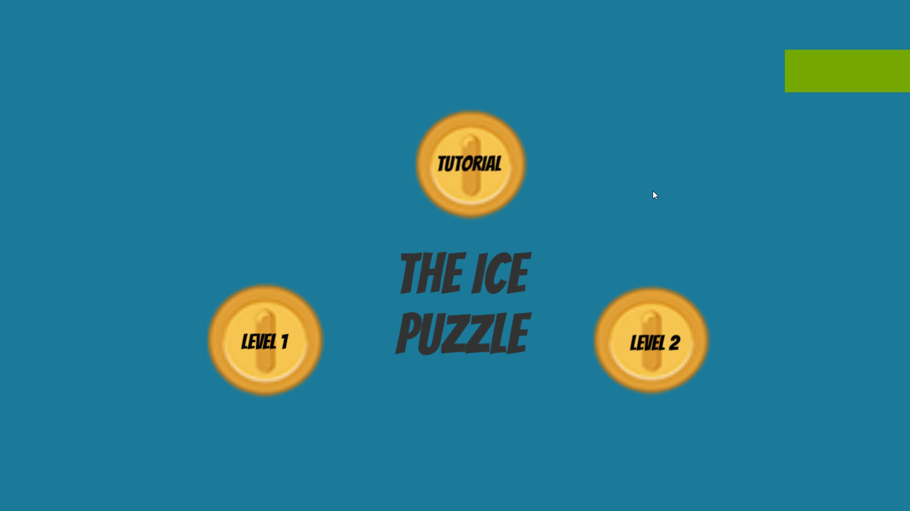
Walkthrough Video
Collect Keys to open the level exit.
Gather Coins to increase the Timer.
If the Timer reaches 0, the level restarts.

Slide 5
Deliverables – Week 12
3 stages – 9 levels – 1 bonus level – 10 levels in total,
Art assets fully implemented,
Animations
Characters
Scenery
Objects, pickups and props.
Audio
Playtesting sessions – Refine core game loop,
All planned mechanics to be completed and implemented,
Ghost enemy
Coins and Keys

Slide 6
OPEN FLOOR ANY QUESTIONS?

